Slide 1
Dataframes

Slide 2
What is a dataframe
Two-dimensional, labeled table of data
Tabular / spreadsheet-like data
Mixed data (numeric, text, dates, categories)
Purpose: Data cleaning, filtering, merging, analysis

Slide 3
Array v. Dataframe v. Excel
Feature
Array
Dataframe
Excel
Structure
Metadata
Data types
Column names
Row labels
Data cleaning
Automation
Grid of values
Minimial
One type for entire array
No
No
Limited
Yes (code)
Labeled table
Structured
Mixed types allowed
Yes
Yes
Excellent
Yes (code)
Spreadsheet
Informal
Mixed types allowed
Yes
Limited
Mainly manual
Limited

Slide 4
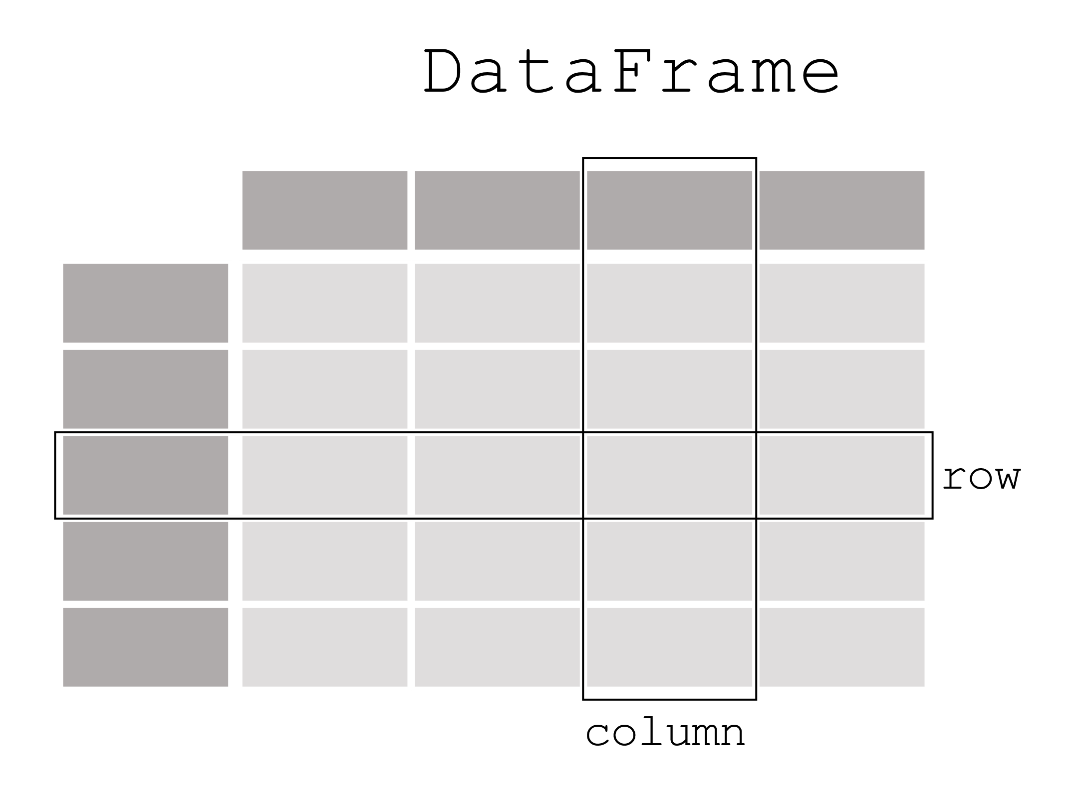
What does a dataframe look like?

Slide 5
Data and metadata
Data
The actual values
e.g., trade = 120.5
Metadata
Information about the data:
Variable definitions
Units (USD, %, index)
Time coverage
Source
Coding schemes (e.g., country codes)

Slide 6
Mixed types
Arrays: Only hold one type of data—numeric or string
Dataframes: Columns can hold mixed data types
But should hold one type per column

Slide 7
Size considerations
Strings are costly while numbers are cheaper
Repeated strings are costly
Additional rows or columns are costly
NOT ON TEST

Slide 8
Unique identifiers
Variable or combination of variables that uniquely identifies dataframe observations
Index is not sufficient
Know your data and unit of analysis
Dataframe specific

Slide 9
Unit of analysis
Entity of unit at which data are measured
Many options: individual, country, country-year
Should be guided by your research question
Not always equivalent to unique identifier

Slide 10
Missing data
Arrays: Missing values complicate things
Need complete matrices for multiplication
Dataframes: Built to handle messy/incomplete data
Drop rows with missing values in analysis: Listwise deletion

Slide 11
Missing data, part 2
Important to understand why data is missing
Missing Values Can Have Meaning:
Survey non-response
Question not applicable
Data collection error
Genuinely unknown
Issues with merging (coming up)
Always investigate unexpected missing values

Slide 12
Five takeways (so far)
What is unit of analysis?
What does each row represent
What is unique identifier?
What variable or variables form key?
What are variables and their types?
What variables do I need and in what format?
What is structure of data?
Long or wide?
What metadata is needed?
How are variables coded? From where?

Slide 13
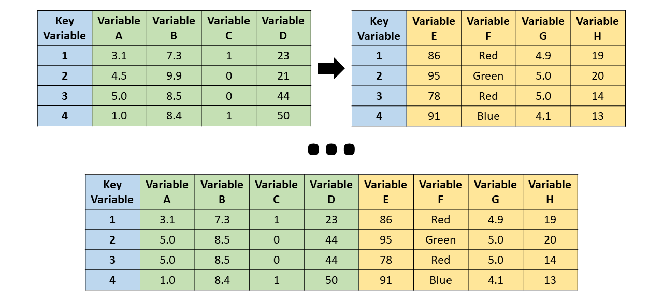
Merging data

Slide 14
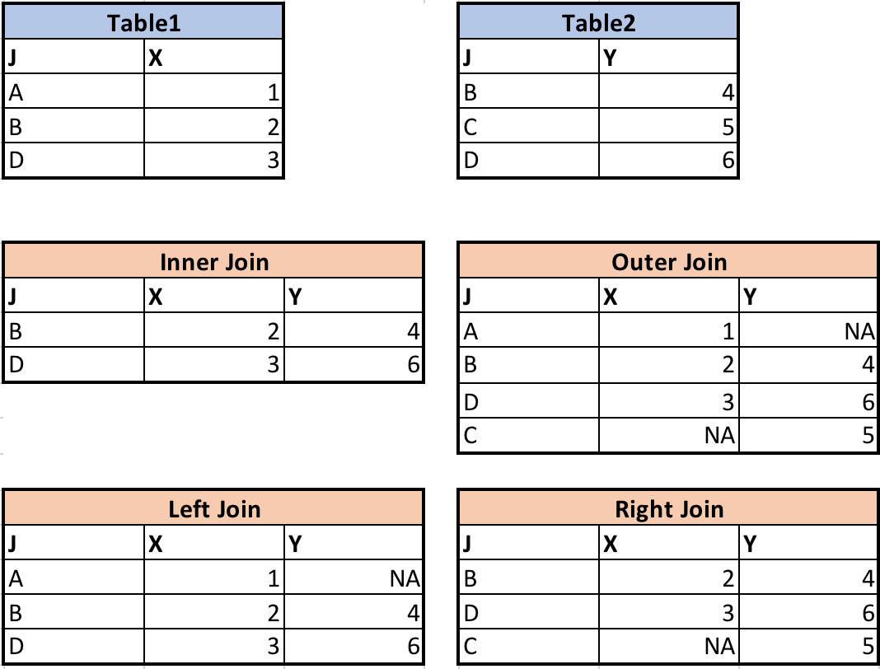

Slide 15
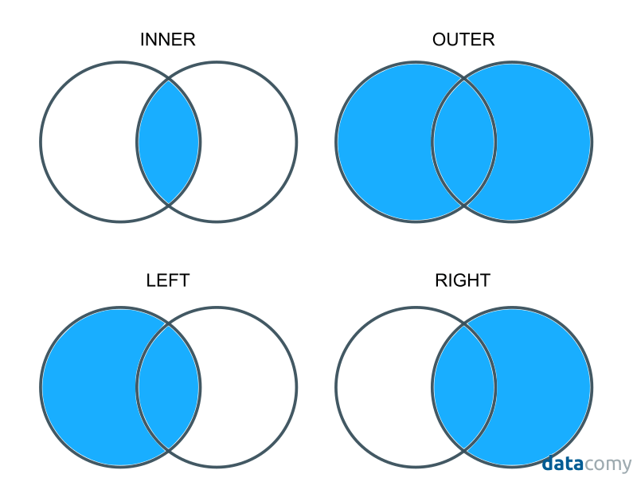

Slide 16
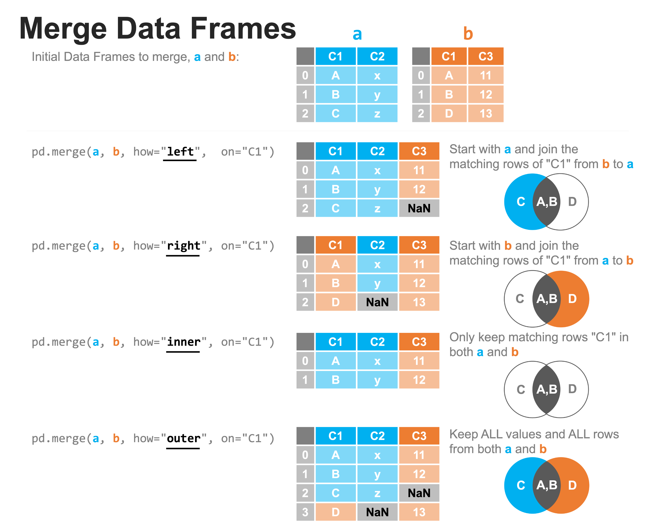

Slide 17
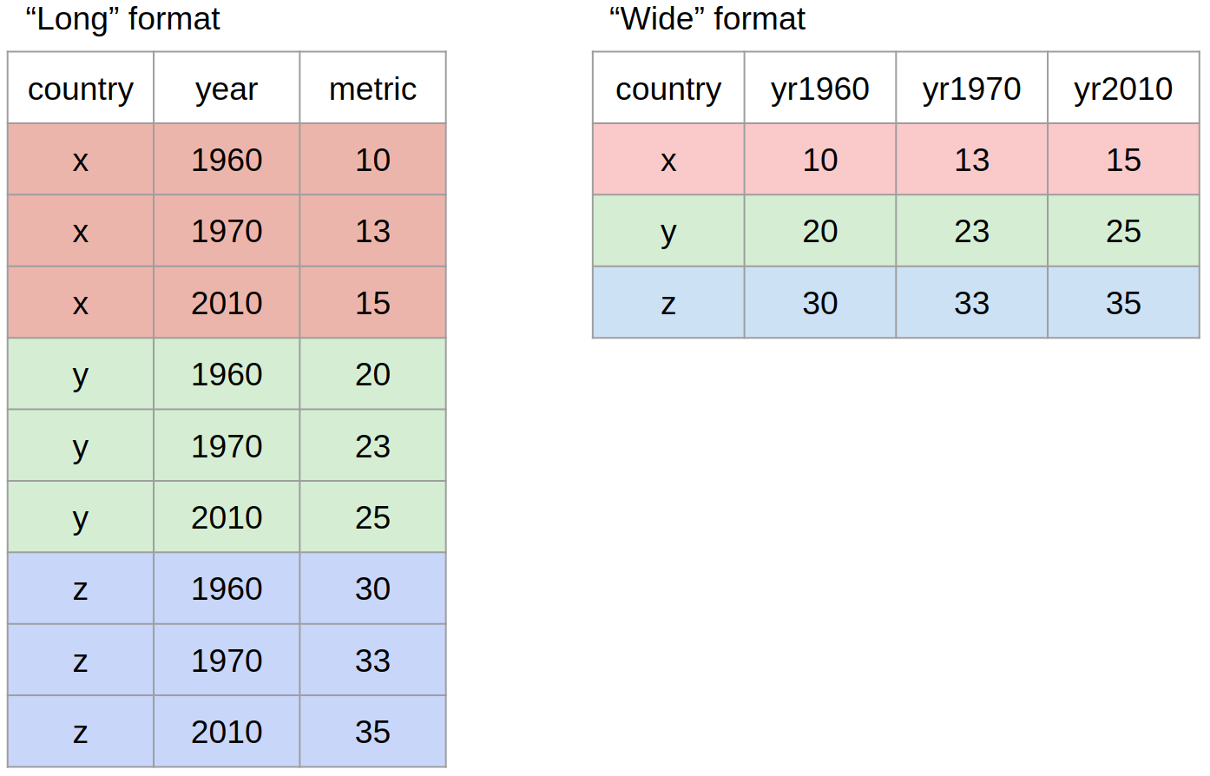
Reshaping data
Wide data: each variable has own column
Long data: multiple rows for unique entity
Reshaping: converting from wide to long or from long to wide

Slide 18
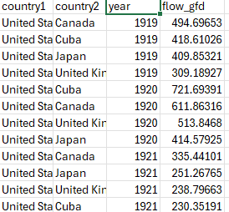


Long and Wide data
Long and wide relative concepts
Data can be wide on some variables and long on others
No “correct” format—data structure depends on analysis goal

